Slide 1
AD_DATA VISUALISATION
File created on: 31-10-2024 21:08:55

Slide 2
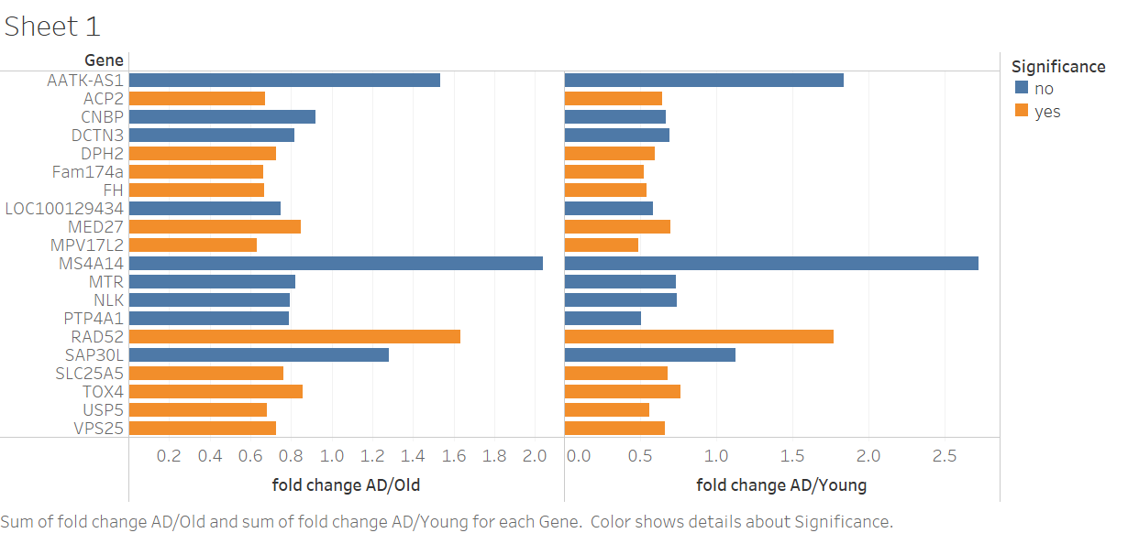

Slide 3
